Slide 1

INFORMATION SECURITY
PRESENTED BY :
APURVA KUMAR SINGH

Slide 2
FORMAL DEFINITION
Information security, often referred to as InfoSec, refers to the processes and tools designed and deployed to protect sensitive business information from modification, disruption, destruction, and inspection.

Slide 3
Why We need Information Security
Information has becomes Valuable Assest.
example – world war II
Without Proper or purposeful Information Any Organization ran out of business easily.
example – IBM, Yahoo etc.
The need for keeping information secret arises from the use of computers in sensitive fields such as government and industry.

Slide 4
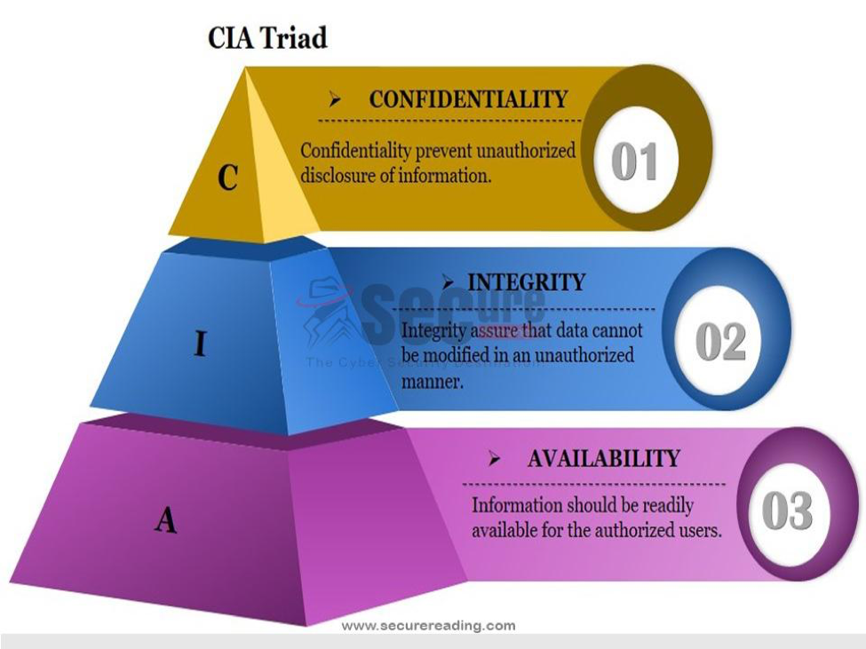
Foundations of Information Security
CIA TRIAD

Slide 5

Confidentiality
Confidentiality is the concealment of information or resources.
example : Firms keep their proprietary design secure lest their competitors
try to steal design. Example : Apple – windows Case.
Access Control Mechanism supports confidentiality. One access control mechanism is cryptography, which scrambles data to make it incomprehensible.

Slide 6

Threats to Confidentiality
Hacker
Masquerades
Unauthorized user activity
Unprotected download files

Slide 7

Integrity
Integrity refers to the trustworthiness of data or resources, and it is usually phrased in terms of preventing improper or unauthorized change.
Integrity includes data integrity (the content of the information) and origin integrity (the source of the data, often called Authentication).
Integrity mechanisms fall into two classes: Prevention mechanism and detection mechanism.
Prevention mechanism seek to maintain the integrity of the data by blocking any unauthorized attempt to change the data in unauthorized way.
The other arises in the case of where user allowed to do some change in a way but he tries to make change in other way.
Detection mechanism do not try to prevent integrity violation.

Slide 8
Examples of the system where high level of Integrity is required :
- Customer Account.
- Financial and Non – Financial Data.
- Payroll Systems.

Slide 9
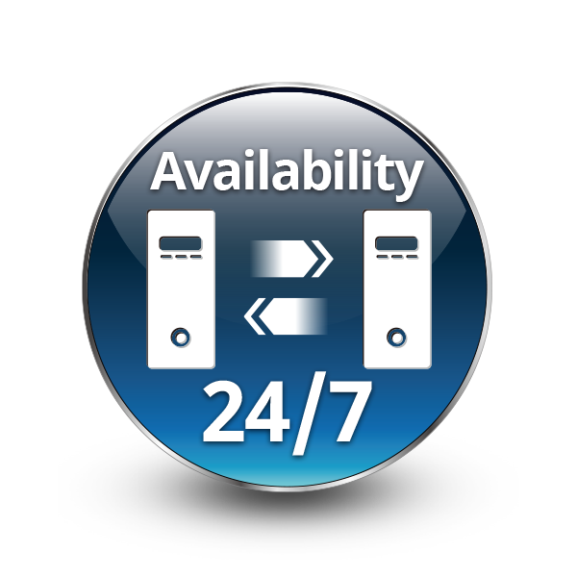
Availability
Availability refers to the ability to use the information or resource desired.
Availability is an important aspect of reliability as well as of system design because an unavailable system is at least as bad as no system at all.
Examples : Denial of services (DoS) attack.

Slide 10
Questions
Q> A third party (e.g. spy ) is not able to read the message when :-
options: 1. The message is sent with integrity.
2. The message is using cryptographic protocol to implement confidentiality.
3. The message has high availability.
Q> Select the best answer. You prepared a report and sending it to your supervisor for her feedback. Select from the list below the file format that has the highest potential for preserving
options: 1: Text format
2: MS Word format
3: Pdf format

Slide 11
thank YOU

